Slide 1
AI: Unveiling the Fundamentals
Powered by AI
AI Basics | 2025-03-20

Slide 2
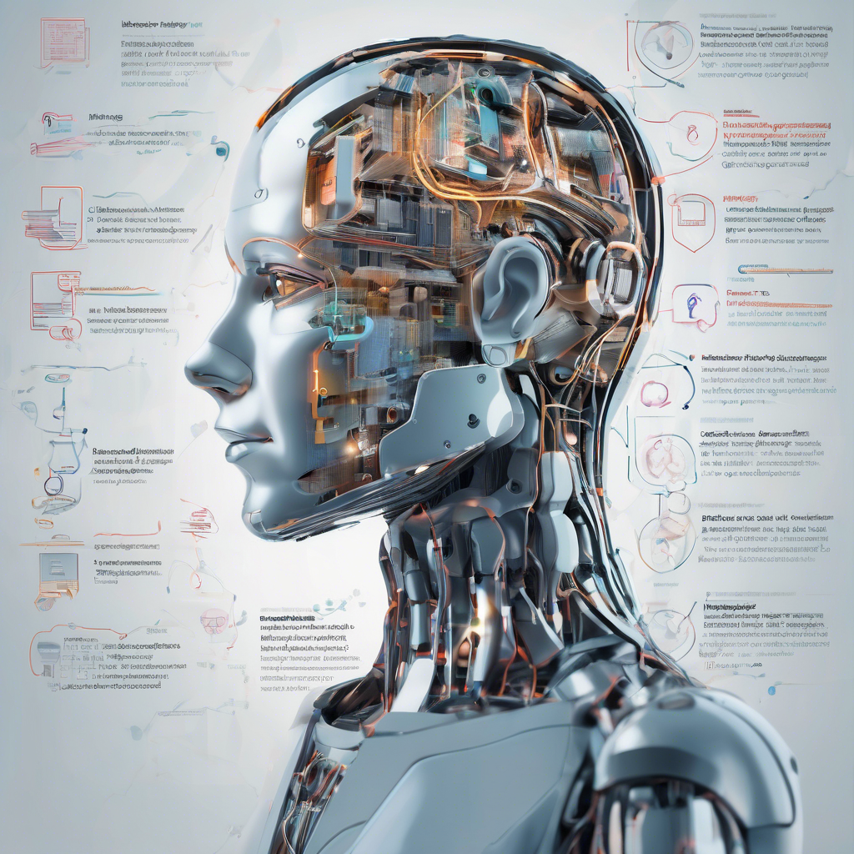
AI: Unveiling the Fundamentals
AI mimics human intelligence through algorithms, learning from data to solve problems and make decisions. Key areas include machine learning, deep learning, and natural language processing.
These technologies power applications like image recognition, language translation, and robotics, constantly evolving with new advancements and ethical considerations.
AI Basics | 2025-03-20

Slide 3
Machine Learning: Algorithms in Action
Explores core machine learning algorithms, illustrating their practical application through diverse examples and clear explanations. Focuses on implementation and understanding, not just theoretical concepts.
Covers various algorithms like linear regression, decision trees, SVMs, and neural networks, equipping readers with practical skills for building predictive models.
AI Basics | 2025-03-20

Slide 4
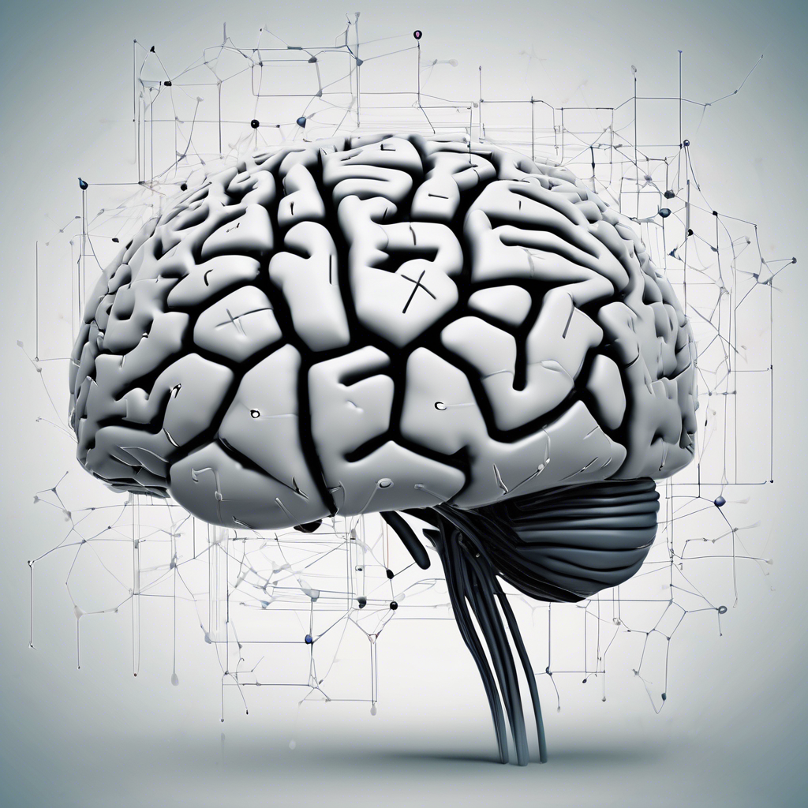
Neural Networks: The Brain-Inspired Model
Neural networks mimic the brain's structure, using interconnected nodes to process information. Learning occurs through adjusting connection strengths based on input data.
These networks excel at pattern recognition, prediction, and complex decision-making, finding applications across numerous fields.
AI Basics | 2025-03-20

Slide 5
AI Basics Future
AI's future involves increasingly sophisticated algorithms and applications across diverse sectors, impacting everything from healthcare to entertainment. Ethical considerations and responsible development will be crucial.
Expect advancements in areas like machine learning, natural language processing, and robotics, leading to automation and enhanced human capabilities.
AI Basics | 2025-03-20

Slide 6
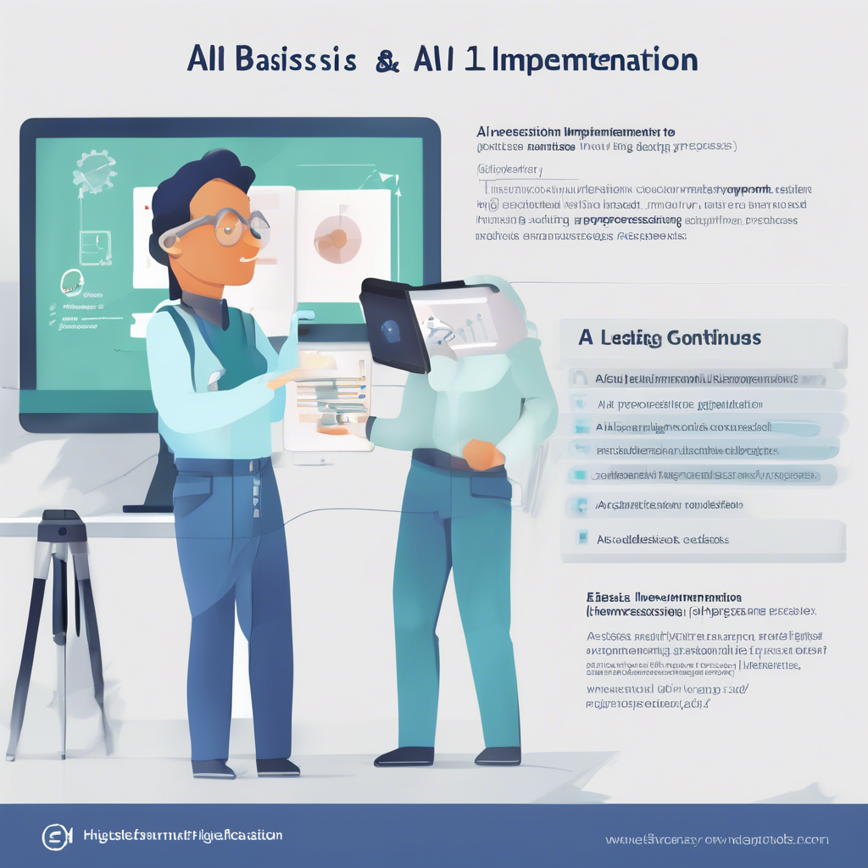
AI Basics Implementation
AI implementation begins with defining clear goals and selecting appropriate algorithms. Data collection, preprocessing, and model training follow.
Successful deployment requires continuous monitoring, evaluation, and iterative improvement to ensure accuracy and ethical considerations.
AI Basics | 2025-03-20

